Slide 1



KONGU ENGINEERING COLLEGE
PERUNDURAI ERODE-638060
MASTER OF COMPUTER APPLICATION
Mentor Hub with Project Tracker & Planner
Team Members: SENTHILKUMAR T (24MCR099)
SHREE VAISHNAVI B (24MCR100)
SUGUMAR M (24MCR109)
Team Mentor with Designation and Department:
Ms.T.Kalpana
Assistant Professor
MCA DEPARTMENT Team Number : 41

Slide 2

ABSTRACT
Mentor Hub with Project Tracker is a full-fledged web application developed using the MERN stack (MongoDB, Express.js, React.js, Node.js).
This platform is designed to enable seamless real-time collaboration for coding projects, team-based workspaces, and simplified project management.
It includes key features such as user authentication using JWT, where users can securely log in and manage their profiles, and real-time collaboration powered by Socket.io.
The collaboration allows users to code simultaneously in team workspaces, where changes are updated in real-time.
Each team can manage multiple projects through a dashboard that offers functionalities such as task creation, progress tracking, and team member assignment.
24-Dec-2024
Team _41 02

Slide 3
PROPOSED ADVANTAGES
EXISTING ADVANTAGES
1.Limited Task Management Features
Basic task management tools on traditional platforms often lack progress tracking | A project dashboard with advanced task management features, enabling teams to assign tasks, set due dates, and track progress.
2.Login & Sign-Up
There’s no login & sign up page for user in existing project | It enables one-click Google Account sign-up, offering quick, secure access
24-Dec-2024
Team _41 03

Slide 4
3.Comprehensive Project Management
Lacking features like team assignments, due dates, or progress tracking, which hampers project oversight and coordination. | It provides full functionality for creating tasks, tracking progress, and assigning team members.
4.Real-time Coding Collaboration
Requiring users to refresh manually or wait for version updates, which can disrupt workflow and slow down development. | It uses Socket.io to enable real-time collaboration, where team members, leading to faster feedback loops and more efficient workflows.
5.Customizable Workspaces
Standard platforms typically offer rigid workspace structures, limiting customization for teams. | It allows customizable team workspaces, enabling users to tailor their environment to fit specific project needs.
24-Dec-2024
Team _41 04

Slide 5
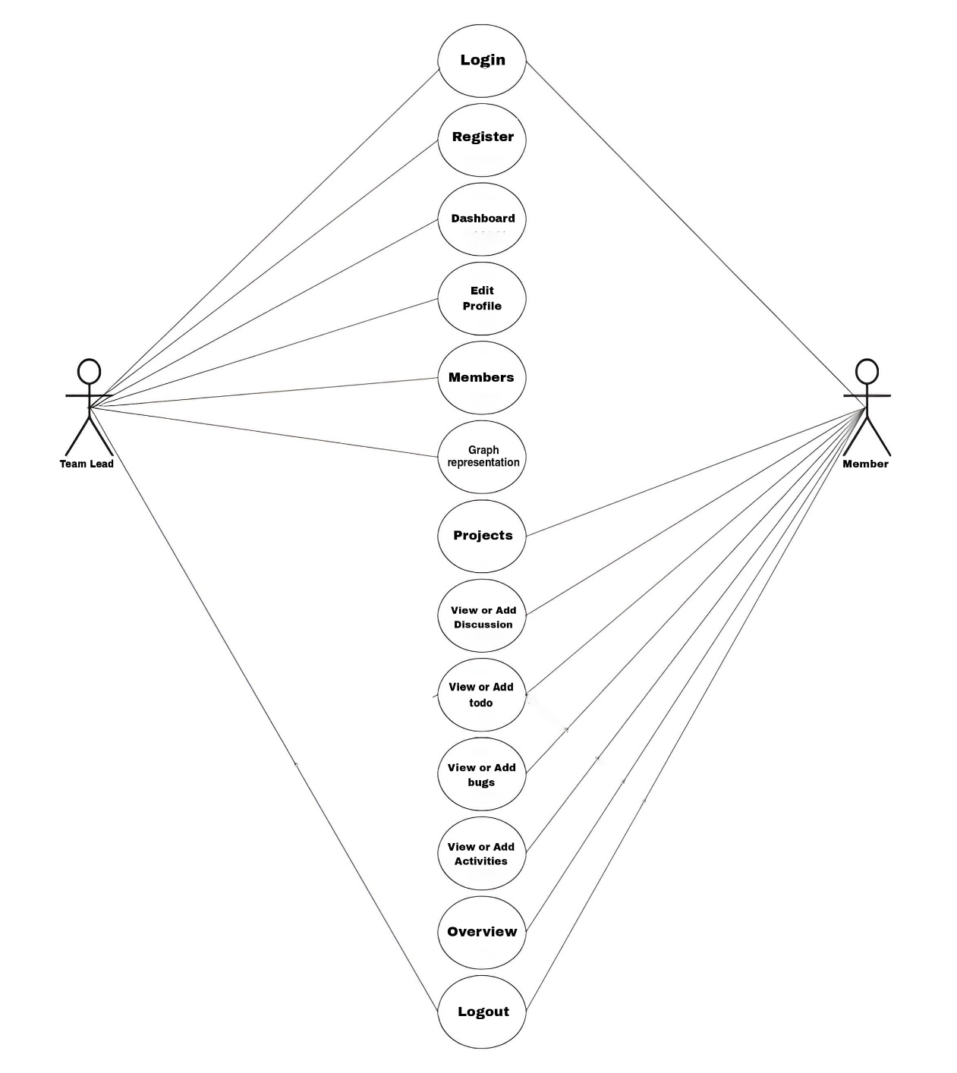
USE CASE DIAGRAM
24-Dec-2024
Team _41 05

Slide 6
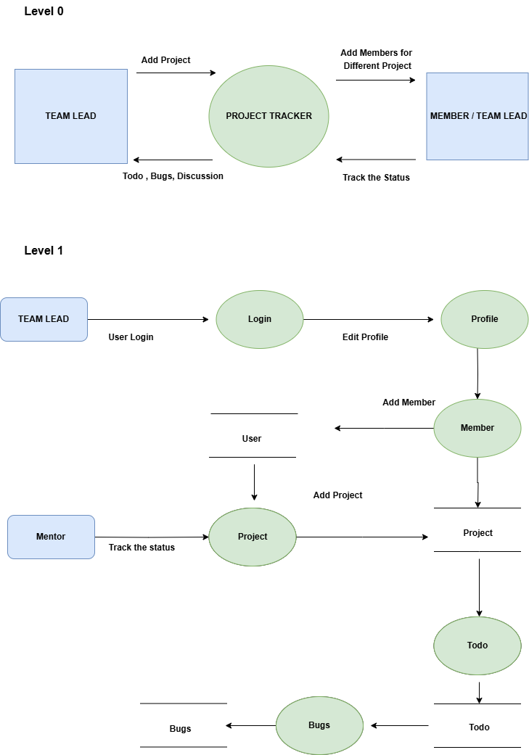
DATA FLOW DIAGRAM
24-Dec-2024
Team _41 06

Slide 7
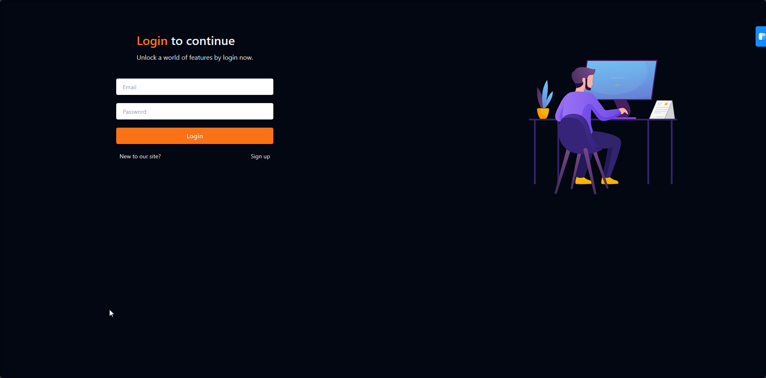
SCREEN SHOT
Login Page
24-Dec-2024
Team _41 07

Slide 8
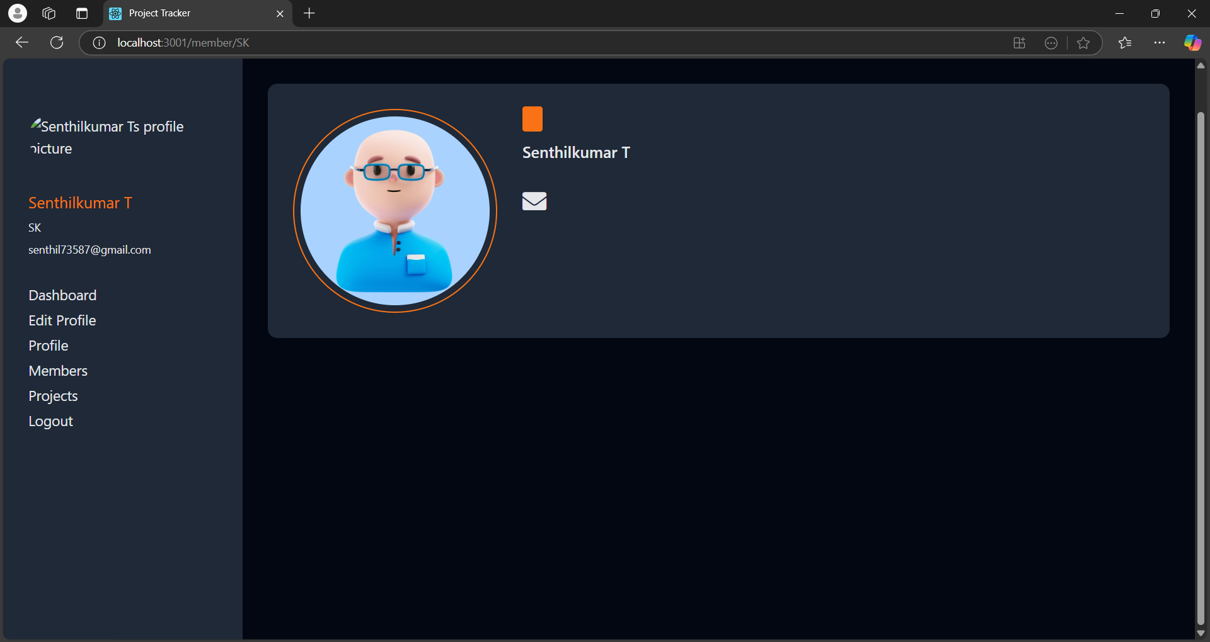
User Profile Page
24-Dec-2024
Team _41 08

Slide 9
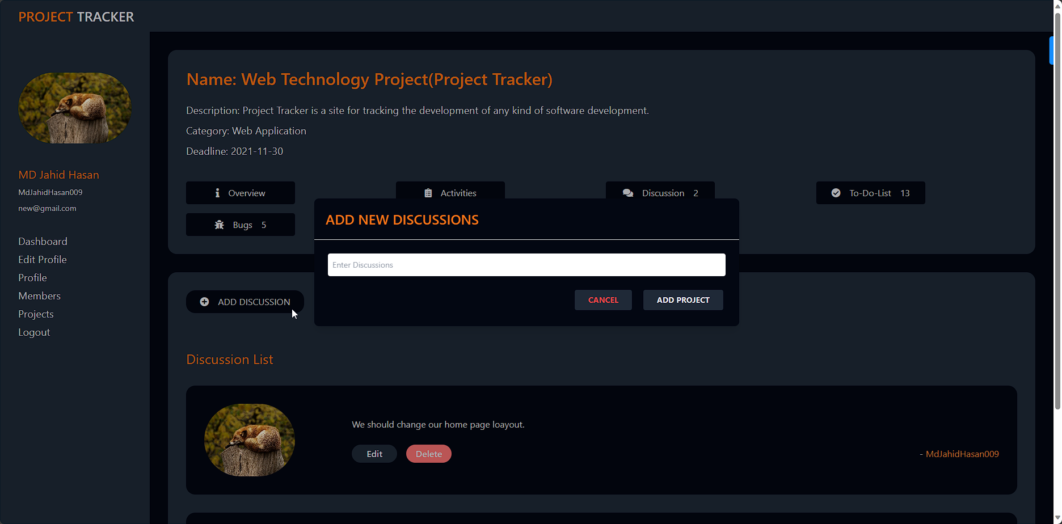
Project Discussions Page
24-Dec-2024
Team _41 09

Slide 10
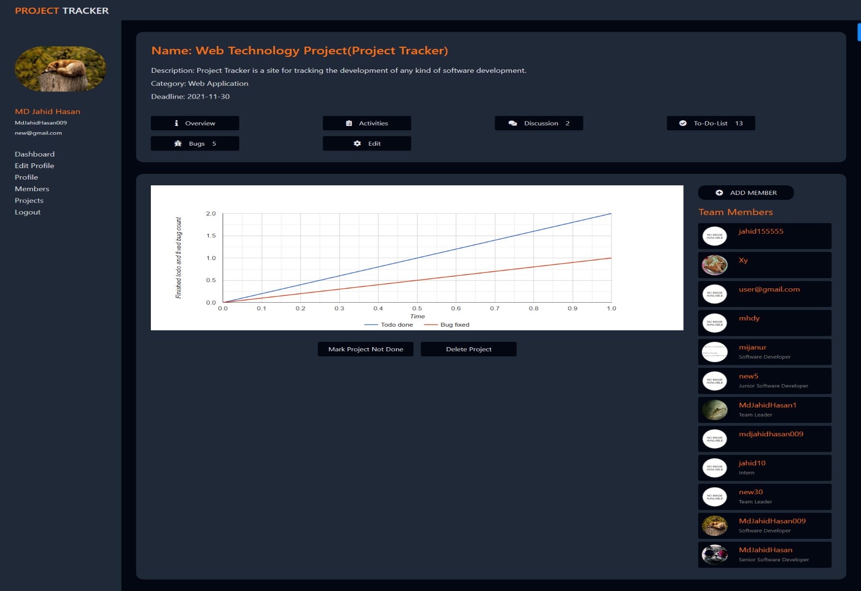
Project Overview Page
24-Dec-2024
Team _41 10

Slide 11
CONCLUSION
The Mentor Hub project successfully streamlines project management, team collaboration, and task tracking in a cohesive platform. With features like secure user authentication, real-time discussion, and project tracking, it offers a comprehensive solution for effective team coordination.
The system’s design focuses on usability and functionality, making it a useful tool for academic and professional environments. potential to significantly improve communication and workflow, making project management more efficient and organized.
24-Dec-2024
Team _41 11

Slide 12
FUTURE ENHANCEMENT
Augmented Reality (AR) Support: Allowing users to engage with projects and tasks in a more immersive way.
Voice Command Integration: Enable voice-controlled navigation and task management for hands-free use, enhancing accessibility and user experience.
Blockchain for Task Tracking: Use blockchain to securely track task assignments and project milestones, ensuring transparency and verifiability of progress.
Collaborative Code Editor: Implement a collaborative code editor within the platform, allowing users to work on code in real-time with version control.
AI-driven Mentor Matching: Develop an AI algorithm to match users with mentors based on skills, project experience, and learning goals, improving mentor-mentee connections.
24-Dec-2024
Team _41 12

Slide 13
THANK YOU
24-Dec-2024
Team _41 13

